Slide 1
Project Presentation of Industry Oriented Hands on Experience (22CS422)
On
PREPX
Kalash Thakur 2211985023 Supervised by
Gaurav Sharma 2211985020 Dr. Rajat Takkar
Ruhael Singh 2211985042
Mahikshit Choudhary 2211985031
Department of Computer Science and Engineering,
Chitkara University, Punjab

Slide 2
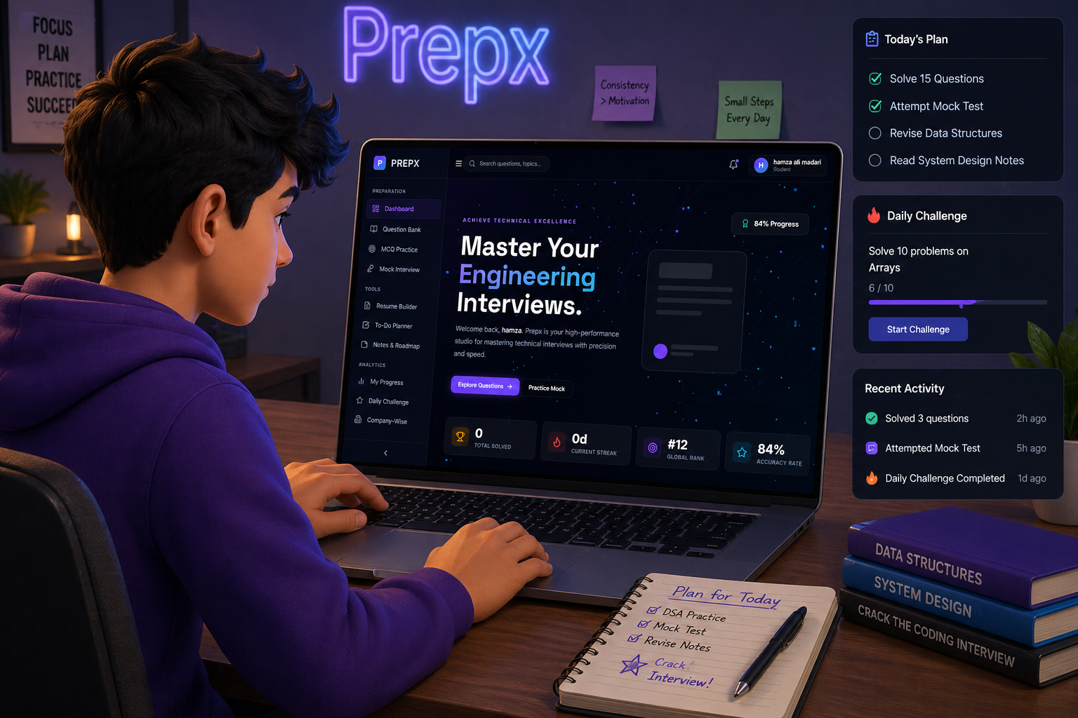
.
Welcome to Prep-X
Introducing Prepx: a modern platform for structured interview preparation. Our website helps students “Prepare smarter, perform better.” It connects learners with curated questions, mock interviews, and productivity tools to streamline their journey from preparation to placement, ensuring focused learning, continuous improvement, and interview success.

Slide 3
.
The Problem: Why Prep-X?
Inefficient Preparation Methods
Many students struggle with scattered resources and unstructured study approaches, leading to low success rates in interviews.
Common Challenges
Think of coding doubts, weak concepts, low accuracy, lack of structured planning, and interview anxiety.

Slide 4
.
Our Solution: Centralized Platform
1
Easy to use
2
All-in-One Platform
Prepx offers a clean, intuitive platform designed for seamless interview preparation.
Prepx brings everything into one place—question bank, mock interviews, productivity tools, and analytics—so users can prepare without switching between multiple platforms.
3
Productivity Tools
Stay organized with built-in tools like resume builder, to-do planner.

Slide 5

.
Key Features of Prep-X
Structured Practice
Topic-wise questions, difficulty levels, and curated sets ensure focused and systematic preparation.
Goal Oriented Planning
Built-in to-do planner and roadmap help users stay organized and aligned with their targets.
Company Focused Prep
Company-wise question sets, , targeted preparation aligned with company expectations.

Slide 6
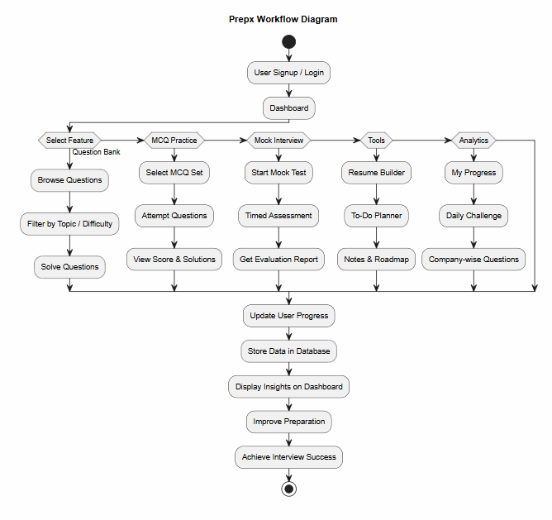
-
WORKFLOW Diagram

Slide 7
.
Thank You

